Slide 1

CSE101-Lec#23
Strings

Slide 2
Outline
Introduction to string
Declaration
Initialization
Reading and writing strings
functions of the standard input/output library (stdio.h)
Processing of strings.
String Manipulation Functions from the String Handling Library
Comparing strings
Determining the length of string
All string operations without inbuilt functions
Other programs related to strings

Slide 3
Fundamentals of strings
Strings
Array of characters treated as a single unit called string:
Can include letters, digits and special characters (*, /, $)
String literal (string constant) - written in double quotes
“Lovely Professional University."

Slide 4
What is a String??
String is a collection of characters terminated by null character
Strings are arrays of characters
String is a pointer to first character (like array)
Value of string is the address of first character
Each element of the string is stored in a contiguous memory locations.
Terminated by a null character(‘\0’) which is automatically inserted by the compiler to indicate the end of string.

Slide 5
String Definition
They are defined as
char array_name[size];
e.g. char carname[30];
or char *carname;
It defines an array name and reserves 30 bytes for storing characters and single character consumes 1 bytes each.
Since the last byte is used for storing null character so total number of character specified by the user cannot exceed 29.

Slide 6
String Initialization
String Initialization
Two ways:
Define as a character array or a variable of type char *
char color[] = "blue"; //char array
Or char color[] = { 'b', 'l', 'u', 'e', '\0' };
char *colorPtr = "blue"; //pointer variable
Remember that strings represented as character arrays end with '\0'
color has 5 elements
b | l | u | e | \0
b | l | u | e | \0
color
Temporary
*colorPtr

Slide 7
String Input/Output
Inputting strings
Use scanf.
scanf("%s", word);
Copies input into word[]
Do not need & (because a string is a pointer)
Remember to leave last place in the array for '\0‘.
Because array knows no bounds the string written beyond char array size will overwrite the data in memory.
Displaying strings
Use printf.
printf("%s", word);

Slide 8
#include <stdio.h>
int main()
{
char carname[20]; //string char array
printf(“Enter the name of your car: ");
scanf("%s", carname);// to display the input
printf(“\nName of car is %s”, carname);
} //end main
Program to read and display string
Enter the name of your car: XUV500
Name of car is XUV500
Output

Slide 9
How?
The last program will print only a single word not the sentences with white spaces?
That is if input is
Lovely Professional University
Output will be:
Lovely
So how to print:
Lovely Professional University
use gets and puts

Slide 10
Standard I/O Library Functions
List of functions in #include<stdio.h>
Used for string input/output functions.
Function | Description
gets( char *s ); | Inputs characters from the standard input into the array s until a newline or end-of-file character is encountered. A terminating null character is appended to the array.
puts( const char *s ); | Prints the string s followed by a newline character.

Slide 11
#include <stdio.h>
int main()
{
char name[100]; //string char array
puts(“\nEnter a string:”);
gets(name); //to input string with space
printf(“\nString is:”)
puts(name); //to output const string
}//end main
Program to print strings with white spaces using library functions
Enter a string:
Lovely Professional University
String is:
Lovely Professional University
Output

Slide 12
Drawback of gets():
gets() has been removed from c11. So it might give you a warning when implemented. We see here that it doesn’t bother about the size of the array. So, there is a chance of Buffer Overflow.
Alternative of gets():
To overcome the above limitation, we can use fgets as : Syntax : char *fgets(char *str, int size, FILE *stream) Example : fgets(str, 20, stdin); as here, 20 is MAX_LIMIT according to declaration.
#include <stdio.h>
#define MAX_LIMIT 20
int main()
{
char str[MAX_LIMIT];
fgets(str, MAX_LIMIT, stdin);
printf("%s", str);
return 0;
}

Slide 13
Multiple words input using scanf():
1)
#include <stdio.h>
int main()
{
char str[20];
scanf("%[^\n]%*c", str);
printf("%s", str);
return 0;
}
Here, [] is the scanset character. ^\n tells to take input until newline doesn’t get encountered. Then, with this %*c, it reads newline character and here used * indicates that this newline character is discarded.
2)
#include <stdio.h>
int main() {
char str[100];
scanf("%[^\n]s",str);
printf("%s",str);
return 0;
}

Slide 14
#include <stdio.h>
int main()
{
char name[]=“Hello”; //string char array
int i=0;
while(name[i]!='\0') //untill null character
{
printf("%c",name[i]);
i++;
}//end while
}//end main
Program to print strings character by character using loop.
Hello
Output

Slide 15
String Handling Library
Functions defined in #include<string.h>
String handling library provides many useful functions:
Manipulate string data(copy and concatenate)
Comparing strings
Determine string length

Slide 16
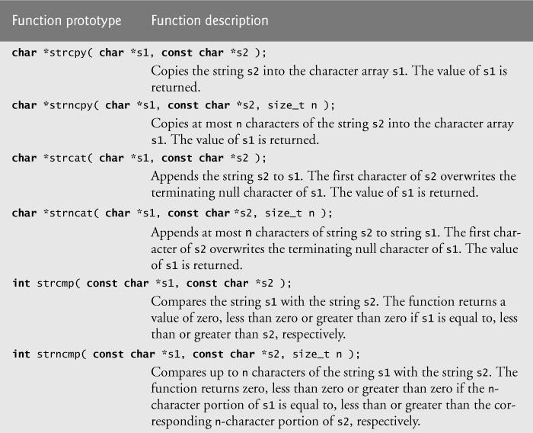
String Manipulation Functions(or Functions in string library)

Slide 17
More functions in string library
strlen()-It is used to find the length of string without counting the null character
strrev()-It is used to display the reverse of a string
strlwr()-Converting a string from upper to lower case
strupr()-Converting a string from lower to upper case

Slide 18
strcpy() and strncpy()
strcpy() copies the entire second argument string into first argument.
strcpy( s1, s2);
strncpy() copies the first n characters of second string argument into first string argument.
strncpy( s1, s2, 4);
A null character ('\0') is appended explicitly to first argument, because the call to strncpy in the program does not write a terminating null character.
The third argument is less than the string length of the second argument.

Slide 19
Examples
//strcpy() function
#include<stdio.h>
#include<string.h>
int main()
{
//strcpy function
char ori[20],dup[20];
char *z;
printf("\n Enter your name:");
gets(ori);
z=strcpy(dup,ori);
printf("Original String is:%s",ori);
printf("\nDuplicate String is:%s",dup);
printf("\n Value of z is:%s",z);
return 0;
}
//strncpy()
#include<stdio.h>
#include<string.h>
int main()
{
char str1[15],str2[15];
int n;
printf("\nEnter Source String:");
gets(str1);
printf("\nEnter Destination String:");
gets(str2);
printf("Enter number of characters to copy in destination string:");
scanf("%d",&n);
strncpy(str2,str1,n);
printf("Source string is:%s",str1);
printf("\nDestination String is:%s",str2);
return 0;
}

Slide 20
strcat()
Function strcat appends its second argument string to its first argument string.
strcat( s1, s2);
The array used to store the first string should be large enough to store
the first string
the second string and
the terminating null character copied from the second string.

Slide 21
strncat()
Function strncat appends a specified number of characters from the second string to the first string.
strncat( s1, s2, 6)
A terminating null character is automatically appended to the result.

Slide 22
Examples
//strcat
#include<stdio.h>
#include<string.h>
int main()
{
char str1[20],str2[10];
printf("\n Enter first string:");
gets(str1);
printf("\n Enter second string:");
gets(str2);
strcat(str1,str2);
printf("\n String after concatenation:%s",str1);
return 0;
}
//strncat
#include<stdio.h>
#include<string.h>
int main()
{
char str1[20],str2[10];
int n;
printf("\n Enter first string:");
gets(str1);
printf("\n Enter second string:");
gets(str2);
printf("\n Enter number of characters you want to combine:");
scanf("%d",&n);
strncat(str1,str2,n);
printf("\n String after concatenation:%s",str1);
return 0;
}

Slide 23
Comparison Functions of the String Handling Library
Comparing strings
Computer compares numeric ASCII codes of characters in string
strcmp() Compares its first string argument with its second string argument, character by character.
Function strncmp() does not compare characters following a null character in a string.

Slide 24
strcmp()
int strcmp( const char *s1, const char *s2 );
Compares string s1 to s2
Returns
a negative number if s1 < s2,
zero if s1 == s2
a positive number if s1 > s2

Slide 25
strncmp()
int strncmp( const char *s1, const char *s2, int n);
Compares up to n characters of string s1 to s2
a negative number if s1 < s2,
zero if s1 == s2
a positive number if s1 > s2

Slide 26
Examples
// strncmp
#include<stdio.h>
#include<string.h>
int main()
{
char str1[20],str2[10];
int x,n;
printf("\n Enter first string:");
gets(str1);
printf("\n Enter second string:");
gets(str2);
printf("\n Enter no. of characters to compare:");
scanf("%d",&n);
x=strncmp(str1,str2,n);
if(x==0)
{
printf("\n Strings are equal");
}
else if(x>0)
{
printf("\n First string is greater than second string(strings are not equal)");
}
else
{
printf("\n First string is less than second string(strings are not equal)");
}
return 0;
}
//strcmp
#include<stdio.h>
#include<string.h>
int main()
{
char str1[20],str2[10];
int x;
printf("\n Enter first string:");
gets(str1);
printf("\n Enter second string:");
gets(str2);
x=strcmp(str1,str2);
if(x==0)
{
printf("\n Strings are equal");
}
else if(x>0)
{
printf("\n First string is greater than second string(strings are not equal)");
}
else
{
printf("\n First string is less than second string(strings are not equal)");
}
return 0;
}

Slide 27
stricmp()[Ignore case], stricmp will ignore the case
#include<stdio.h>
int main()
{
char str1[20],str2[10];
int x;
printf("\n Enter first string:");
gets(str1);
printf("\n Enter second string:");
gets(str2);
x=stricmp(str1,str2);
if(x==0)
{
printf("\n Strings are equal");
}
else if(x>0)
{
printf("\n First string is greater than second string(strings are not equal)");
}
else
{
printf("\n First string is less than second string(strings are not equal)");
}
return 0;
}
//consider str1(HELLO) and str2(hello) and if we apply stricmp on these strings, then 0 will be returned, as strings are equal

Slide 28
Determining the length of string
strlen()
Function strlen in #include<string.h>
Function strlen() takes a string as an argument and returns the number of characters in the string
the terminating null character is not included in the length

Slide 29
Example
#include<stdio.h>
#include<string.h>
int main()
{
char str[]="Hello";
printf("\n Length of the given string is:%d",strlen(str));
return 0;
}

Slide 30
strrev()-Example
#include<stdio.h>
#include<string.h>
int main()
{
char s[100]="Hello";
printf("%s",strrev(s));
return 0;
}

Slide 31
strlwr(),strupr()-Examples
#include<stdio.h>
#include<string.h>
int main()
{
char s[]="hello";
strupr(s);
puts(s);
strlwr(s);
puts(s);
return 0;
}

Slide 32
All string operations without inbuilt functions
Copying one string to another
Finding length of a string
Concatenation(or Combining) of two strings
Comparing two strings
Displaying reverse of a number
Checking whether a given string is palindrome or not
Converting all characters of a given string from lowercase to uppercase
Converting all characters of a given string from uppercase to lowercase

Slide 33
WAP to copy one string to another without using strcpy()/or inbuilt function
#include<stdio.h>
int main() {
char s1[100], s2[100];
int i;
printf("\nEnter the string :");
gets(s1);//Hello
i = 0;
while (s1[i] != '\0') {
s2[i] = s1[i];
i++;
}
s2[i] = '\0';
printf("\nCopied String is %s ", s2);
return (0);
}

Slide 34
WAP to find the length of a string without using strlen()/ or inbuilt function
#include<stdio.h>
int main()
{
char x[100];
int i=0;
printf("\n Enter String:");
gets(x);
while(x[i]!='\0')
{
i++;
}
printf("\n Length of the string is:%d",i);
return 0;
}

Slide 35
WAP to concatenate(or combine) two strings without using strcat/ or inbuilt function
#include<stdio.h>
int main()
{
char str1[100],str2[100],str3[200];
int i=0,j=0;
printf("\n Enter the first string:");
gets(str1);
printf("\n Enter the second string:");
gets(str2);
while(str1[i]!='\0')
{
str3[j]=str1[i];
i++;
j++;
}
i=0;
while(str2[i]!='\0')
{
str3[j]=str2[i];
i++;
j++;
}
str3[j]='\0';
printf("\n The concatenated string is:");
puts(str3);
return 0;
}

Slide 36
WAP to compare two strings without using strcmp()/ or inbuilt function
#include <stdio.h>
#include<string.h>
int main ()
{
// declare variables
char str1 [30], str2 [30];
int i = 0, flag=0 ,length1, length2, length;
// take two string input
printf ("Enter string1:");
gets (str1);
printf ("\nEnter string2:");
gets (str2);
//length of both string
length1 = strlen (str1);
length2 = strlen (str2);
if(length1>length2)
length=length1;
else
length=length2;
while (i<length)
{
if( str1 [i] == str2 [i])
{
i++;
continue;
}
if( str1 [i] < str2 [i])
{
flag = -1;
break;
}
if( str1 [i] > str2 [i])
{
flag = 1;
break;
}
}
if (flag == 0)
printf ("\nBoth strings are equal ");
if(flag == -1)
printf ("\nstring1 is less than string2 ");
if( flag == 1)
printf ("\nstring1 is greater than string2 ");
return 0;
}

Slide 37
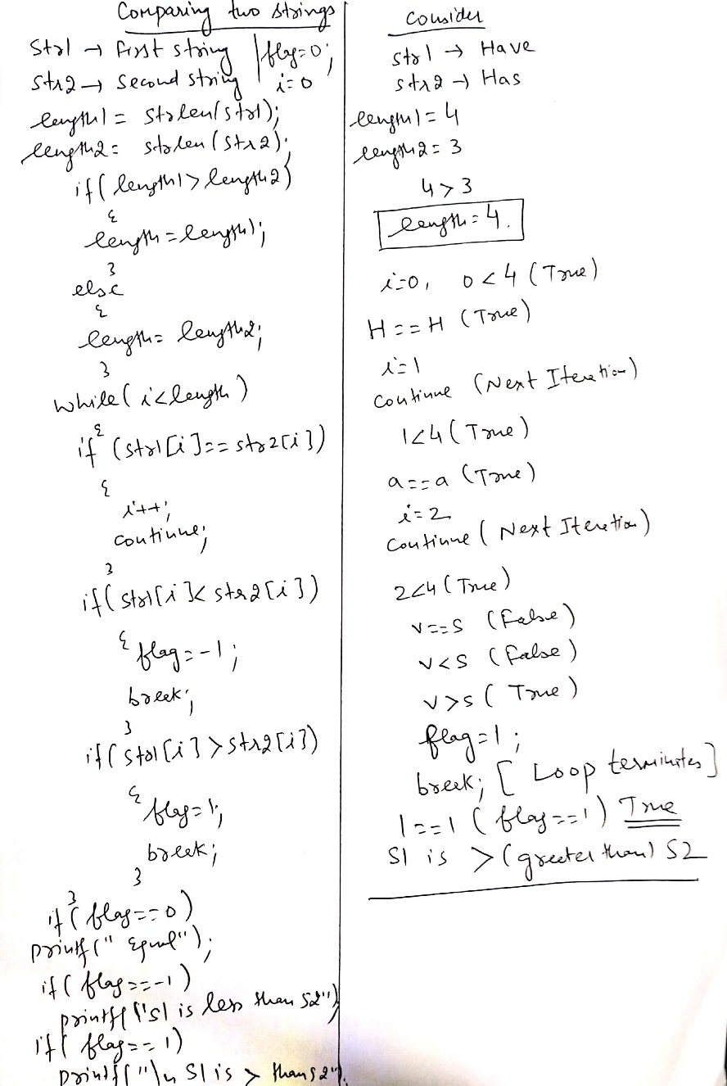
Dry running

Slide 38
WAP to display the reverse of a given string without strrev()/ or inbuilt function
#include<stdio.h>
#include<string.h>
int main() {
char str[100], temp;
int i, j;
printf("\nEnter the string :");
gets(str);
i = 0;
j = strlen(str) - 1;
while (i < j) {
temp = str[i];
str[i] = str[j];
str[j] = temp;
i++;
j--;
}
printf("\nReverse string is :%s", str);
return (0);
}

Slide 39
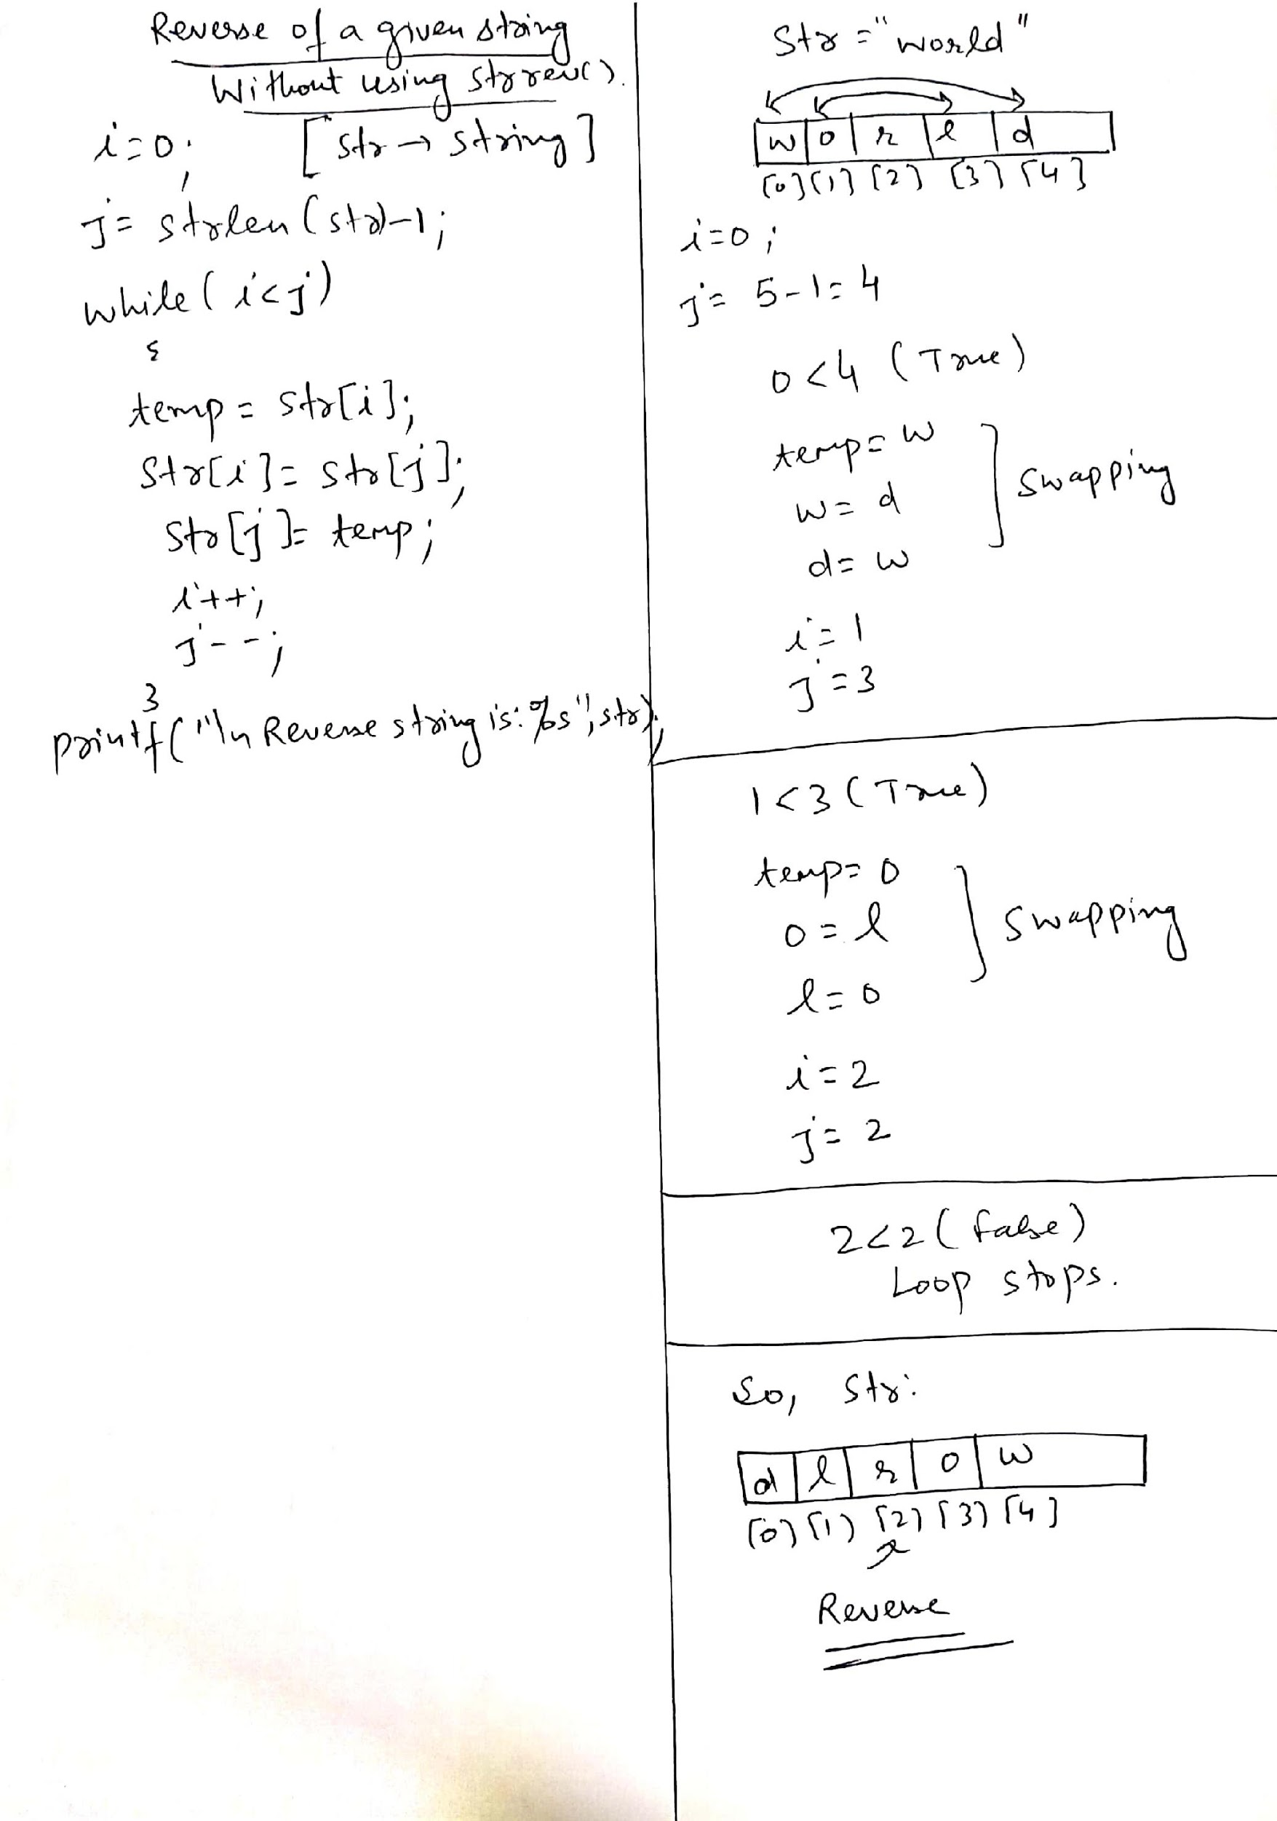
Dry running

Slide 40
WAP to check whether the given string is palindrome or not(without using strrev())
#include<stdio.h>
#include<string.h>
int main() {
char str[100], temp;
char str1[100];
int i, j;
printf("\nEnter the string :");
gets(str);
i = 0;
j = strlen(str) - 1;
strcpy(str1,str);
while (i < j)
{
temp = str[i];
str[i] = str[j];
str[j] = temp;
i++;
j--;
}
if(strcmp(str1,str)==0)
{
printf("\n Given String is Palindrome");
}
else
{
printf("\n Not a Palindrome");
}
return (0);
}

Slide 41
WAP to convert all characters of a given string into uppercase without using strupr()/or inbuilt function
#include<stdio.h>
#include<string.h>
int main()
{
char str1[10];
int i,len;
printf("Enter any string \t");
gets(str1);
len=strlen(str1);
for(i=0;i<len;i++)
{
if(str1[i]>='a' && str1[i]<='z')
str1[i]=str1[i]-32;
}
puts("string in upper is");
puts(str1);
return 0;
}

Slide 42
WAP to convert all characters of a given string into lowercase without using strlwr()/or inbuilt function
#include<stdio.h>
#include<string.h>
int main()
{
char str1[10];
int i,len;
printf("Enter any string \t");
gets(str1);
len=strlen(str1);
for(i=0;i<len;i++)
{
if(str1[i]>='A' && str1[i]<='Z')
str1[i]=str1[i]+32;
}
puts("string in lower is");
puts(str1);
return 0;
}

Slide 43
More programs on strings

Slide 44
WAP to sort the characters of a given string into ascending order
#include<stdio.h>
#include<string.h>
int main()
{
char s[10],t;
int n,i,j;
printf("\n Enter String:");
gets(s);
n=strlen(s);
for(i=0;i<n-1;i++)
{
for(j=0;j<n-i-1;j++)
{
if(s[j]>s[j+1])
{
t=s[j];
s[j]=s[j+1];
s[j+1]=t;
}
}
}
printf("%s",s);
}

Slide 45
WAP to count vowels in a given string
#include<stdio.h>
int main()
{
char x[100];
int i=0,count=0;
printf("\n Enter the string:");
gets(x);
while(x[i]!='\0')
{
if(x[i]=='a'||x[i]=='e'||x[i]=='i'||x[i]=='o'||x[i]=='u'||x[i]=='A'||x[i]=='E'||x[i]=='I'||x[i]=='O'||x[i]=='U')
{
count++;
}
i++;
}
printf("\n Number of vowels in the string are:%d",count);
return 0;
}

Slide 46
WAP to traverse all characters of a given string using pointer to character
#include<stdio.h>
int main()
{
char *g="C Programming";
int length=0,i=0;
while(*g!='\0')
{
printf("%c",*g);//Value at address
g++;//Pointer is incremented by 1 after each iteration
length++;//Variable for counting length
}
printf("\nLength of the string is:%d",length);
return 0;
}

Slide 47
WAP to count total no. of characters and words in a given string
#include<stdio.h>
int main()
{
char x[100];
int i=0,length=0,c=0,w=1;
printf("\n Enter String:");
gets(x);
while(x[i]!='\0')
{
if(x[i]==' ' && x[i+1]!=' ')
{
w++;
}
c++;
i++;
}
printf("\n Total number of characters are:%d, and no. of words are:%d",c,w);
return 0;
}

Slide 48
WAP to demonstrate array of strings in C
#include<stdio.h>
int main()
{
char names[5][10];
int i,n;
printf("\n Enter the number of students:");
scanf("%d",&n);
fflush(stdin);
for(i=0;i<n;i++)
{
printf("\n Enter the name of student %d: ",i+1);
gets(names[i]);
}
printf("\n Names of the students are:\n");
for(i=0;i<n;i++)
puts(names[i]);
return 0;
}

Slide 49
WAP to traverse a string character by character
#include <stdio.h>
int main()
{
char name[]="Hello World"; //string char array
int i=0;
while(name[i]!='\0') //untill null character
{
printf("%c\n", name[i]);
i++;
}//end while
}//

Slide 50
WAP to replace all spaces in a given string with ‘$’[Example for character replacement]
#include<stdio.h>
int main()
{
char x[100];
int i=0;
printf("\n Enter the string:");
gets(x);
while(x[i]!='\0')
{
if(x[i]==' ')
{
x[i]='$';//Character replacement
}
i++;
}
printf("\n String after character replacement is:%s",x);
return 0;
}

Slide 51
Output-1??
#include<stdio.h>
int main()
{
char str[]="Practice MCQ";
printf("\n%d",sizeof(str));
return 0;
}
A. 13
B. 12
C. 11
D. 1
Notes:
A

Slide 52
Output-2??
#include<stdio.h>
int main()
{
char str[]="Program";
printf("%c",str[7]);
return 0;
}
A. m
B. Program
C. Compile time error
D. Nothing will be visible
Notes:
D

Slide 53
Output-3??
#include<stdio.h>
int main()
{
char str1[]="Good";
char str2[5];
str2=str1;
printf("%s",str2);
return 0;
}
A. Good
B. Garbage value
C. Compile time error
D. Nothing will be visible
Notes:
C

Slide 54
Output-4??
#include<stdio.h>
int main()
{
char str1[]="Good";
char *str2;
str2=str1;
puts(str2);
return 0;
}
A. Good
B. Garbage value
C. Compile time error
D. Nothing will be visible
Notes:
A

Slide 55
Output-5??
#include<stdio.h>
#include<string.h>
int main()
{
char str[20]="Example";
printf("%d %d",sizeof(str),strlen(str));
return 0;
}
A. 7 7
B. 20 20
C. 20 7
D. 20 8
Notes:
C

Slide 56
Output-6??
#include<stdio.h>
#include<string.h>
int main()
{
char str1[20]="Example";
char str2[30]="Exam";
if(strncmp(str1,str2,4))
printf("\nHello");
else
printf("\nWorld");
return 0;
}
A. Hello
B. World
C. Nothing will be printed
D. Compile time error
Notes:
B

Slide 57
Output-7??
What will be the output of the program ?
#include<stdio.h>
#include<string.h>
int main()
{
char str1[20] = "Hello", str2[20] = " World";
printf("%s\n", strcpy(str2, strcat(str1, str2)));
return 0;
}
A. Hello
B. World
C. Hello World
D. WorldHello
Notes:
C

Slide 58
Output-8??
In below program, what would you put in place of “?” to print “Quiz”?
#include <stdio.h>
int main()
{
char arr[] = "HelloQuiz";
printf("%s", ?);
return 0;
}
A. arr
B. (arr+5)
C. (arr+4)
D. Not possible
Notes:
D

Slide 59
Question-9
Which of the following C code snippet is not valid?
(A) char* p = “string1”; printf(“%c”, *++p); (B) char q[] = “string1”; printf(“%c”, *++q); (C) char* r = “string1”; printf(“%c”, r[1]); (D) None of the above
Notes:
B

Slide 60
Output-10 ??
#include<stdio.h>
int main()
{
printf(8+"C Programming\n");
return 0;
}
A. mming
B. ming
C. amming
D. gramming
Notes:
A

Slide 61
Output-11 ??
//Assume unsigned integer takes 4 bytes
#include <stdio.h>
int main()
{
char *str1 = "Hello";
char str2[] = "Hello";
printf("sizeof(str1) = %d, sizeof(str2) = %d",sizeof(str1), sizeof(str2));
return 0;
}
A. sizeof(str1) = 8, sizeof(str2) = 6
B. sizeof(str1) = 4, sizeof(str2) = 6
C. sizeof(str1) = 4, sizeof(str2) = 4
D. sizeof(str1) = 6, sizeof(str2) = 4
Notes:
A

Slide 62
Output-12 ??
Predict the output of the following program:
#include <stdio.h>
int main()
{
char str[] = "%d %c", arr[] = "HelloWorld";
printf(str, 0[arr], 2[arr + 3]);
return 0;
}
A. 72 W
B. H W
C. W H
D. Compile-time error
Notes:
A

Slide 63
Output-13??
#include <stdio.h>
int main()
{
char *str="WORLD";
while(*++str)
{
printf("%c",*str);
}
return 0;
}
ORLD
WORLD
RLD
Compile time error
Notes:
A

